Slide 1

Creating Report Template Using LATEX
ROSP LAB
Department of Information Technology Bharati Vidyapeeth College of Engineering
August 24, 2022

Slide 2
Team Members
Vaibhav Ankolekar [01]
Aman Badge [04]
Ankit Bhoir [07]
Aman Chouhan [14]

Slide 3
Content
Abstract
Introduction
Literature Survey
Proposed Methodology
Diagrams
Requirements
Conclusion
Future Scope

Slide 4
Abstract
Latex Report Template provides core and advanced concepts of Latex. Our Latex Report Template is designed for beginners and working professionals.The Latex is a high-quality typesetting system, used for the documentation of scientific and technical documents. It is widely used in academia for the communication and the publication of scientific papers popularly in fields such as economics, sociology, mathematics, chemistry, physics, engineering, etc. It also handles the formatting layout of different structures. The name is stylized as LATEX.

Slide 5
Introduction
LaTeX was originally written in the early 1980s by Leslie Lamport at SRI International. The current version is LaTeX2e (stylised as LATEX2)
Released in 1994, but updated in 2020. LaTeX3 (LATEX3) has been under long-term development since the early 1990s.
LaTeX is free software and is distributed under the LaTeX Project Public License (LPPL).
LaTeX is widely used in academia for the communication and publication of scientific documents in many fields.
It also has a prominent role in the preparation and publication of books and articles.
LaTeX uses the TeX typesetting program for formatting its output, and is itself written in the TeX macro language.

Slide 6
Literature Survey
Sr.no
Paper Title, year
1
2
3
4
5
Free and works on all operating systems,2021 Editing, Versioning, Automation and Outputs,2020 Focus on Content,2020
Time Investment,2019 Longevity,2019

Slide 7
Literature Survey
1. Free and works on all operating systems, 2021
LaTeX is free and there are a multitude of text editors to choose from for each operating system. If you create a LaTeX .tex file at work on Windows and resume working on it at home on your Mac or Linux computer, the file will compile the same regardless.

Slide 8
Literature Survey
2. Editing, Versioning, Automation and Outputs, 2020
Software developers commonly use source control systems to track changes to files over time. LaTeX is very amenable to using Git to track changes to your documents, something that is difficult to do for documents from a Word Processor.

Slide 9
Literature Survey
3. Focus on Content, 2020
LaTeX separates content and styling/design, and this is especially true when using templates. This ensures consistency since the formatting is handled separately and en masse.

Slide 10
Literature Survey
4. Time Investment, 2019
When using a word processor, time spent trying to fix a formatting problem is essentially time wasted; it is unlikely the same problem will arise again. In LaTeX, once you figure out how to make a formatting change, you now know how to do this forever and it becomes quite natural given some repetition.

Slide 11
Literature Survey
5. Longevity, 2019
Documents written 20 years ago in LaTeX are almost guaranteed to compile today. Compare this with a document produced using a word processor from 20 years ago, it is likely the software no longer exists and if it does, it has undergone so many changes that it may not display the document correctly.

Slide 12
Proposed Methodology
The reason that the design and layout of LaTeX documents can be beautiful is that LaTeX is capable of creating virtually any design by making use of layering and absolute positioning of elements, along with the ability to output text in columns and boxes.
In this sense, LaTeX is as capable as a professional design tool like Adobe InDesign, but without the cost.
A lively community of expansions to LaTeX (called packages) allows virtually any modification and type of document to be created.
This means that LaTeX can create everything from business cards to books to presentations.
Advanced built-in referencing also allows LaTeX to easily handle very large and complex documents with many cross-references, such as theses.

Slide 13
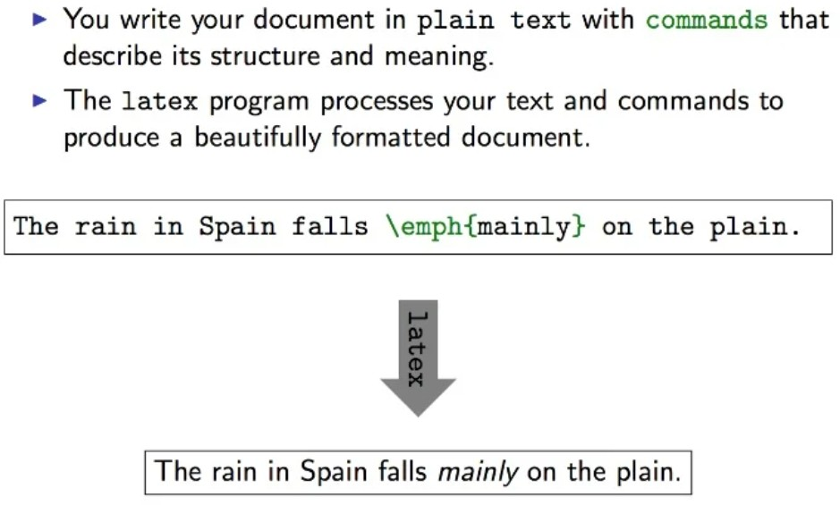
Proposed Methodology

Slide 14
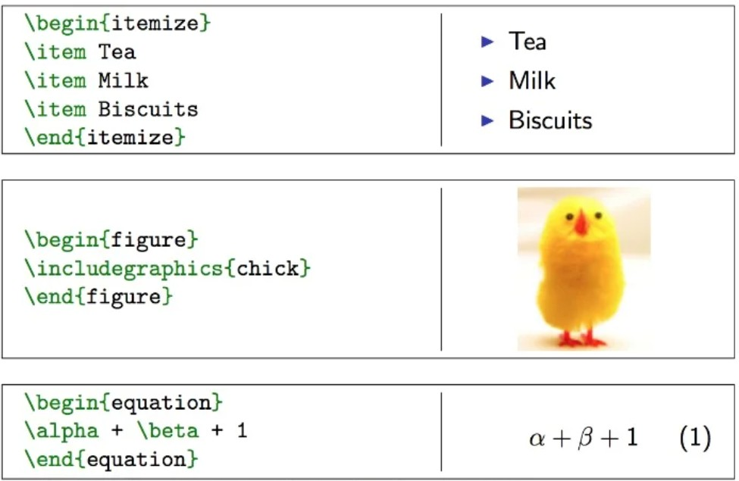
Proposed Methodology

Slide 15
Diagrams
Typography
L^{A}T_{E}X
Design
Coding

Slide 16
Requirements
OS : Windows, Linux, Mac OS
Latex editor : TeXstudio, TexMaker,etc. OR
Online Latex Open Source platform : Overleaf

Slide 17
Conclusion
Creating your own LaTeX theme allows for complete customizability, something you have to work very hard to achieve in more conventional presentational tools. It also makes it trivial to reuse the theme, avoiding wasted effort.
We can conclude that LaTeX and Beamer compose a powerful solution to build presentations. The main benefits of using them consist of a generic and precise way to define graphical resources and the compiling process that automatically generates a PDF file with the presentation.

Slide 18
Future Scope
This Report Template made using Latex can be utilized at professional levels to provide a faster alternative for making business analytics report, project idea proposal,etc.
Also this report can provide great help for interns and new-comers in drafting ideas.

Slide 19
John Smith (2012) Title of the publication
Journal Name 12(3), 45 – 678.
References

Slide 20
Thank You

